Slide 1

PROJECT OVERVIEW AND KEY LEARNING OUTCOMES
EASY
ADVANCED

Slide 2
PROJECT OVERVIEW
We will analyze cryptocurrency prices and daily returns such Bitcoin (BTC), Ethereum (ETH), Litecoin (LTC), Cardano (ADA) and Ripple (XRP) using Matplotlib and Seaborn libraries in AWS SageMaker Studio.
Cryptocurrency is a decentralized digital currency that uses cryptography to secure transactions and do not have a centralized issuing authority (Government or banks).
We will also analyze cancer datasets in AWS SageMaker Studio.
We will learn how to:
Perform data visualization using Seaborn and Matplotlib libraries
Plot single line plot
Plot pie charts
Plot multiple subplots
Plot pairplot and countplot using Seaborn
Plot correlations and heatmaps
Plot distribution plot (distplot)
Plot Histograms
Plot Scatterplots

Slide 3
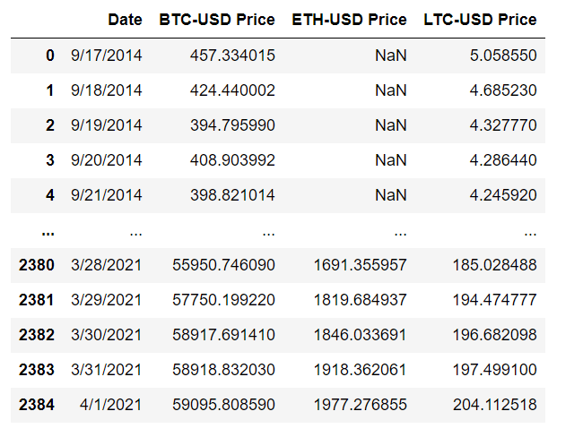
PROJECT OVERVIEW: DATASET #1
CRYPTOCURRENCY PRICES

Slide 4
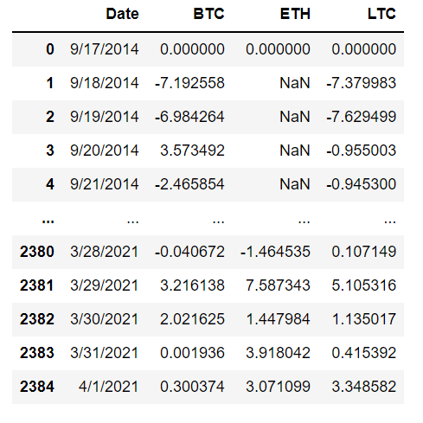
PROJECT OVERVIEW: DATASET #2
CRYPTOCURRENCY RETURNS

Slide 5
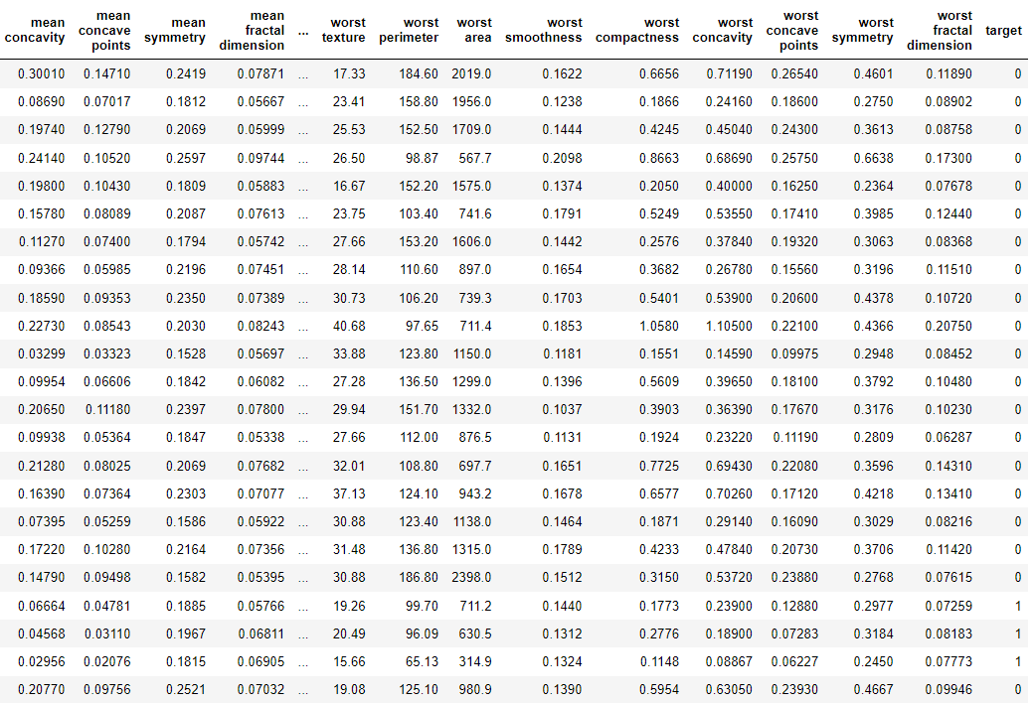
PROJECT OVERVIEW: DATASET #3
BREAST CANCER DATASETS
TARGET CLASS MALIGNANT OR BENIGN
Data Source: https://archive.ics.uci.edu/ml/datasets/Breast+Cancer+Wisconsin+(Diagnostic)

Slide 6
DATA VISUALIZATION 101
EASY
ADVANCED

Slide 7
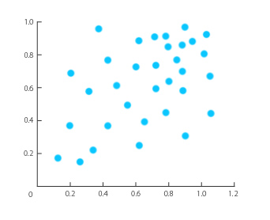
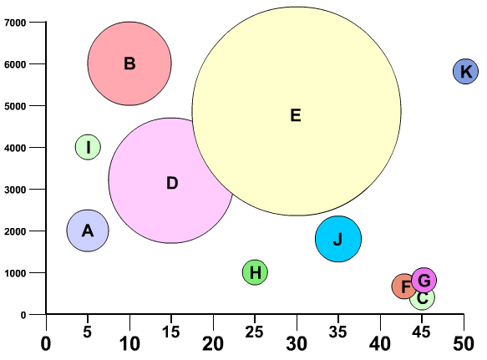
RELATIONSHIPS
SCATTERPLOT
BUBBLE CHART
“Scatterplot demonstrates the relationship between two variables (X, Y)”
“Bubble chart demonstrates the relationship between three variables (X, Y, Bubble Size)
Photo Credit: https://commons.wikimedia.org/wiki/File:Example_of_Scatter_Plot.jpg
Photo Credit: https://commons.wikimedia.org/wiki/File:Bubble_chart.jpg

Slide 8
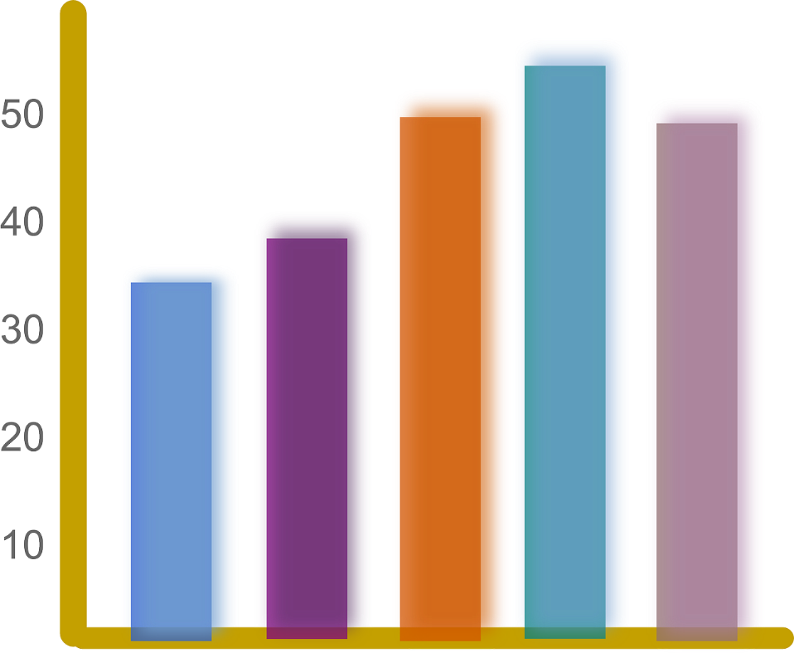
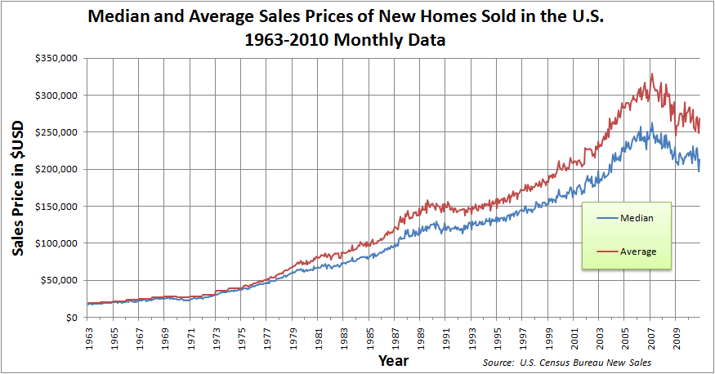
COMPARISONS
BAR CHART
LINE CHART
“Comparing salaries”
“Comparing median and average House prices over the years”
Employee #1
Employee #2
Employee #3
Employee #4
Employee #5
https://www.needpix.com/photo/89660/productivity-statistics-bar-chart-chart-graph-diagram-results
https://commons.wikimedia.org/wiki/File:Median_and_Average_Sales_Prices_of_New_Homes_Sold_in_the_US_1963-2010_Monthly.png

Slide 9
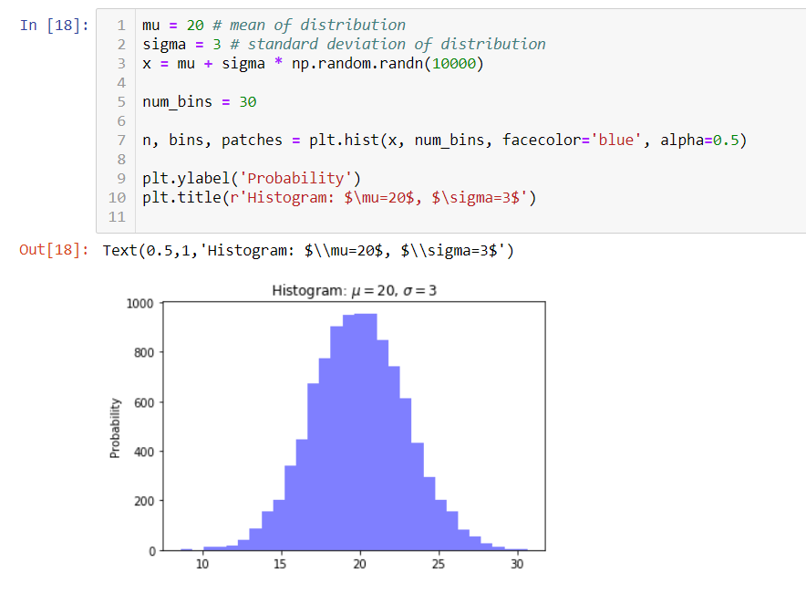
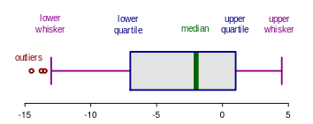
DISTRIBUTIONS
HISTOGRAMS
BOX PLOT
Photo Credit: https://commons.wikimedia.org/wiki/File:Elements_of_a_boxplot_en.svg

Slide 10
BOX PLOT
MAJORITY OF THE DATA
50% PERCENTILE
MINIMUM
MEDIAN
MAXIMUM
Photo Credit: https://commons.wikimedia.org/wiki/File:Elements_of_a_boxplot_en.svg

Slide 11
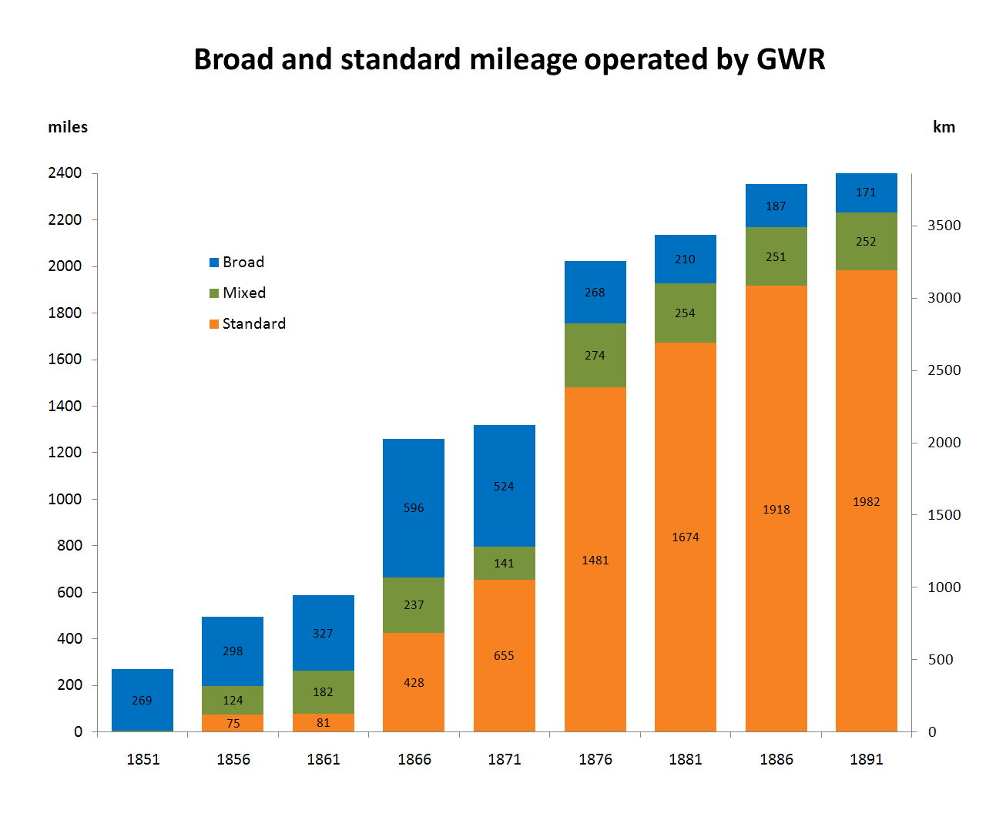
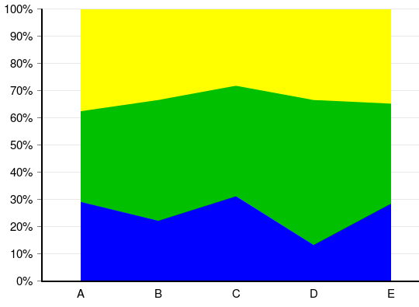
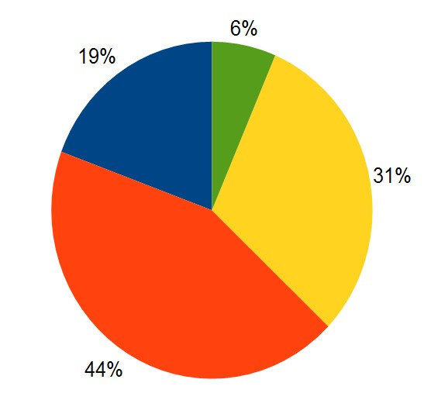
COMPOSITIONS
PIE CHART
STACKED BAR CHART
STACKED AREA CHART
Photo Credit: https://commons.wikimedia.org/wiki/File:Broad_and_standard_mileage_operated_by_GWR.png
Photo Credit: https://commons.wikimedia.org/wiki/File:Charts_SVG_Example_12_-_Stacked_100%25_Area_Chart.svg
Photo Credit: https://commons.wikimedia.org/wiki/File:Pie-chart.jpg

Slide 12
MATPLOTLIB 101
EASY
ADVANCED

Slide 13

MATPLOTLIB
Matplotlib is a comprehensive library for creating static, animated, and interactive visualizations in Python.
Matplotlib is the godfather of data visualization libraries!
Matplotlib was originally written by John D. Hunter. After John’s death, Michael Droettboom was nominated as matplotlib's lead developer in 2012.
Matplotlib can be used to create (1) publication quality plots, (2) Customize figure style, (3) Embed in JupyterLabs and Graphical User Interfaces.
Matplotlib works great with Pandas dataFrames. The plot method on Pandas Series and DataFrames is just a simple wrapper around plt.plot():
Link to Library: https://matplotlib.org/

Slide 14
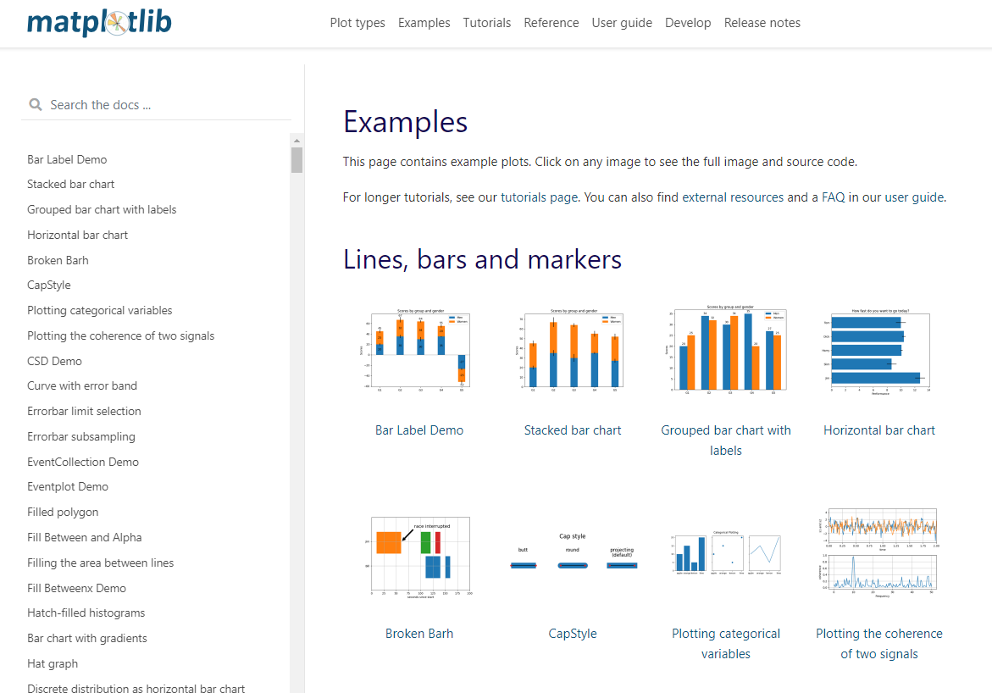
MATPLOTLIB GALLERY
Check this out: https://matplotlib.org/stable/gallery/index

Slide 15
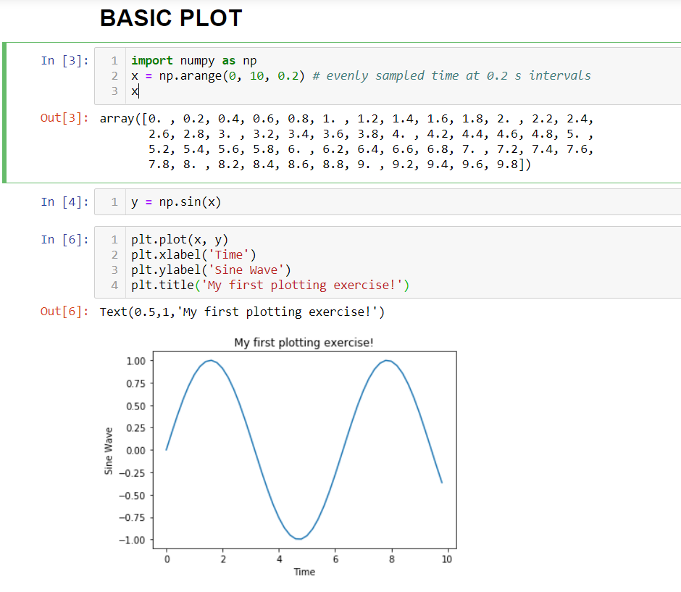
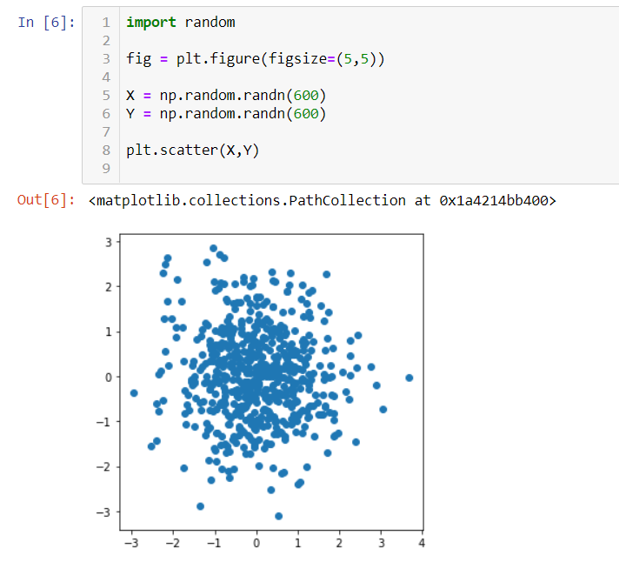
MATPLOTLIB SAMPLE CODE
LINE PLOT
SCATTER PLOT

Slide 16
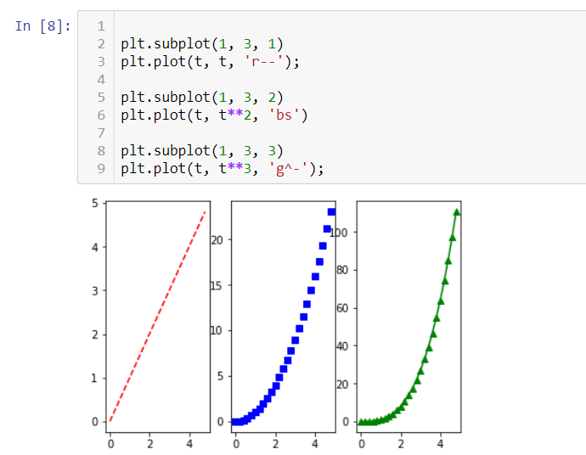
MATPLOTLIB SAMPLE CODE
SUBPLOT
HISTOGRAMS

Slide 17
SEABORN 101
EASY
ADVANCED

Slide 18

SEABORN
Seaborn is a data visualization library that sits on top of matplotlib
Seaborn offers enhanced features compared to matplotlib, it’s Matplotlib on steroids!
Link to Seaborn: https://seaborn.pydata.org/examples/index.html

Slide 19
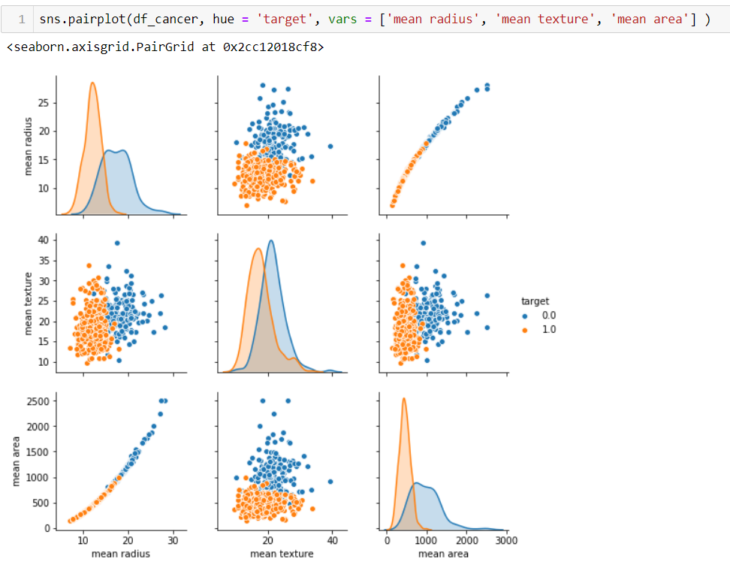
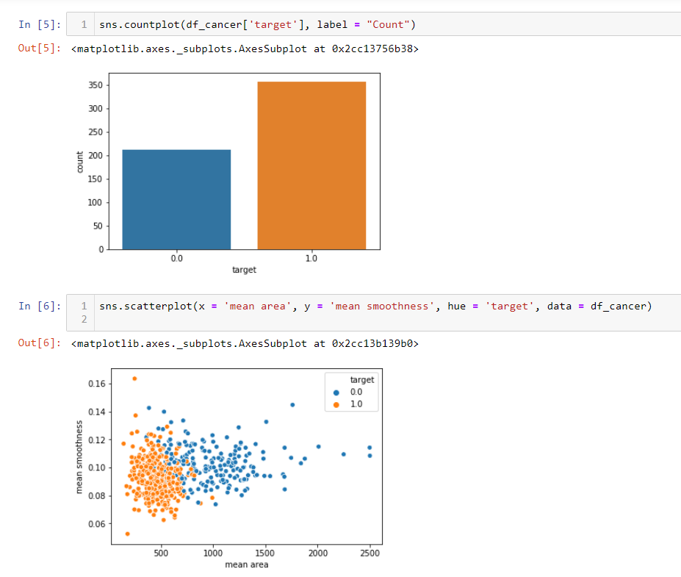
SEABORN EXAMPLES
PAIRPLOT
COUNTPLOT AND SCATTERPLOT

Slide 20
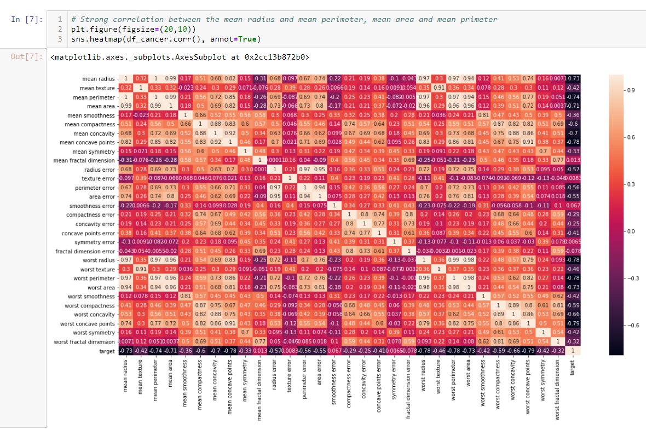
SEABORN EXAMPLES
Heatmaps are used to represents values as colours.
CORRELATIONS AND HEATMAPS

Slide 21
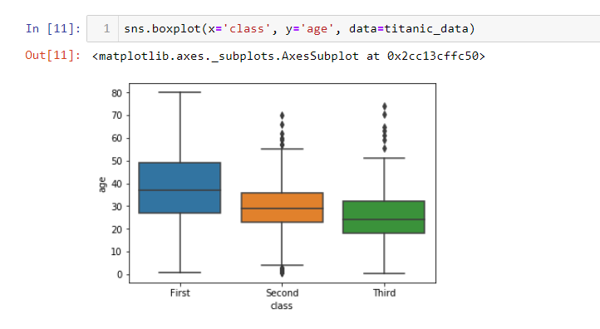
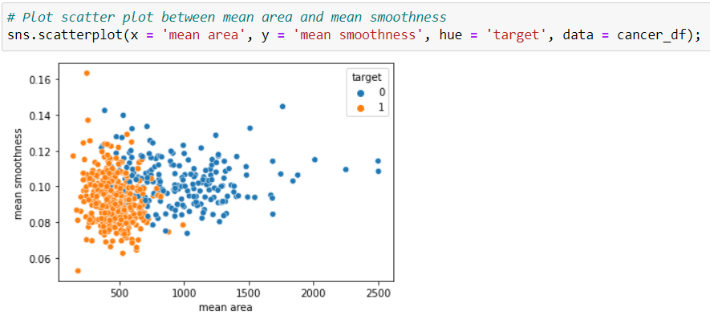
SEABORN EXAMPLES
BOXPLOT
SCATTERPLOT

Slide 22
PROJECT DEMO
EASY
ADVANCED

Slide 23
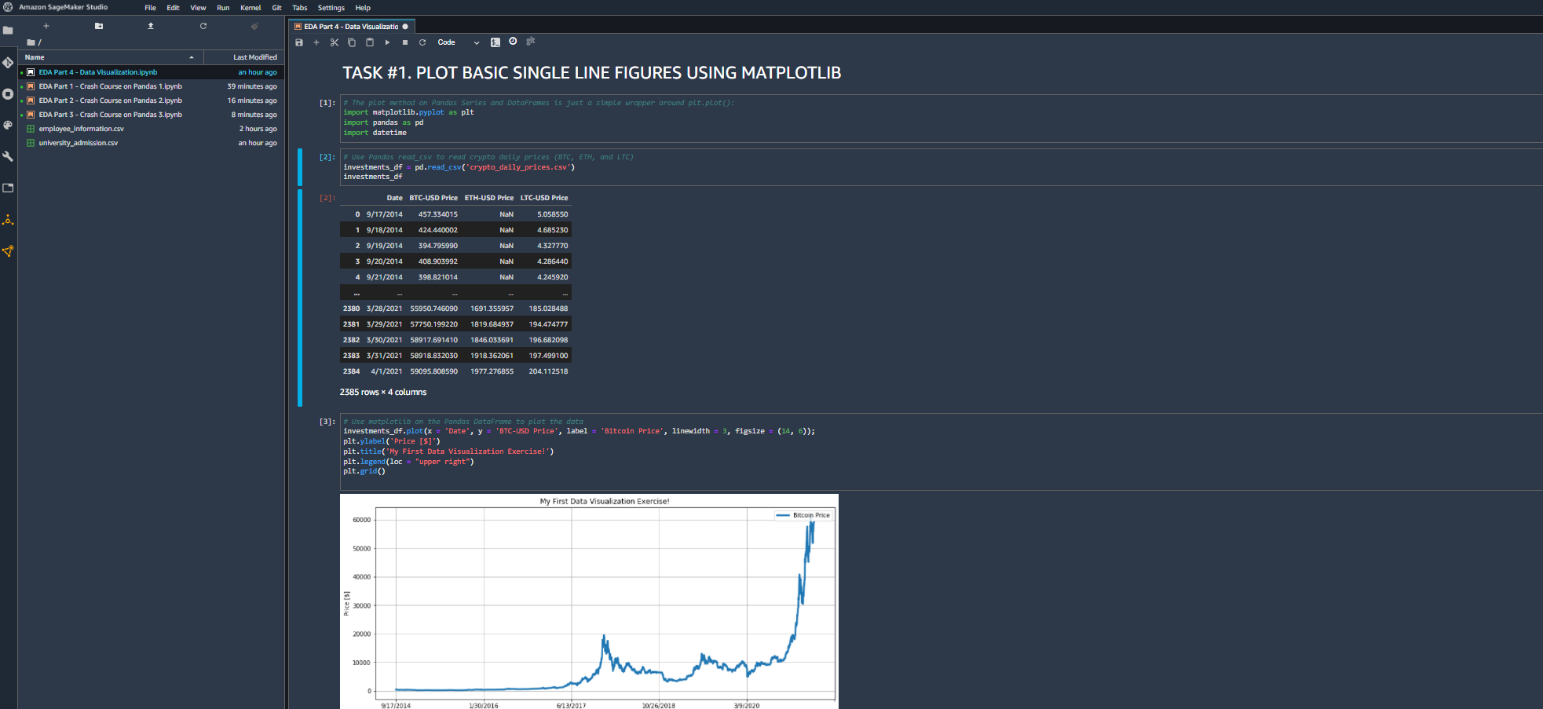
PROJECT DEMO

Slide 24
FINAL END-OF-DAY CAPSTONE PROJECT
EASY
ADVANCED

Slide 25
CAPSTONE PROJECT TASKS
In this project, we will visualize stock prices using Seaborn and Matplotlib. 3 Stocks are considered including Facebook (FB), Twitter (TWTR) and Netflix (NFLX).
Using the stock_daily_prices.csv and stocks_daily_returns.csv dataset included in the course/workshop package, please do the following:
Import both datasets using Pandas.
Using Matplotlib, plot lineplots that display all 3 stocks daily prices on one single figure.
Using Matplotlib, plot 3 stocks daily prices on multiple subplots.
Using Matplotlib, plot the 3 plots on subplots next to each other (all figures in one row).
Using Matplotlib, plot the scatterplot between Facebook and Twitter daily returns.
Using Seaborn, plot similar scatterplot between Facebook and Twitter daily returns.
Assume that you now expanded your portfolio to include additional stocks such as Amazon (AMZN) and Google (GOOG). You decided to become bullish on Twitter and you allocated 60% of your assets in it. You also decided to equally divide the rest of your assets in other stocks (AMZN, FB, GOOG, NFLX). Using Matplotlib, plot a pie chart that shows these allocations. Use 'explode’ attribute to increase the separation between TWTR and the rest of the portfolio.
Using Matplotlib, plot the histogram for FB returns using 40 bins with red color. Display the mean and Standard deviation on top of the figure.
Using Seaborn, plot a heatmap that shows the correlations between stocks daily returns.
Plot a 3D plot showing all daily returns from FB, TWTR and NFLX [External Research is required].

